Slide 1

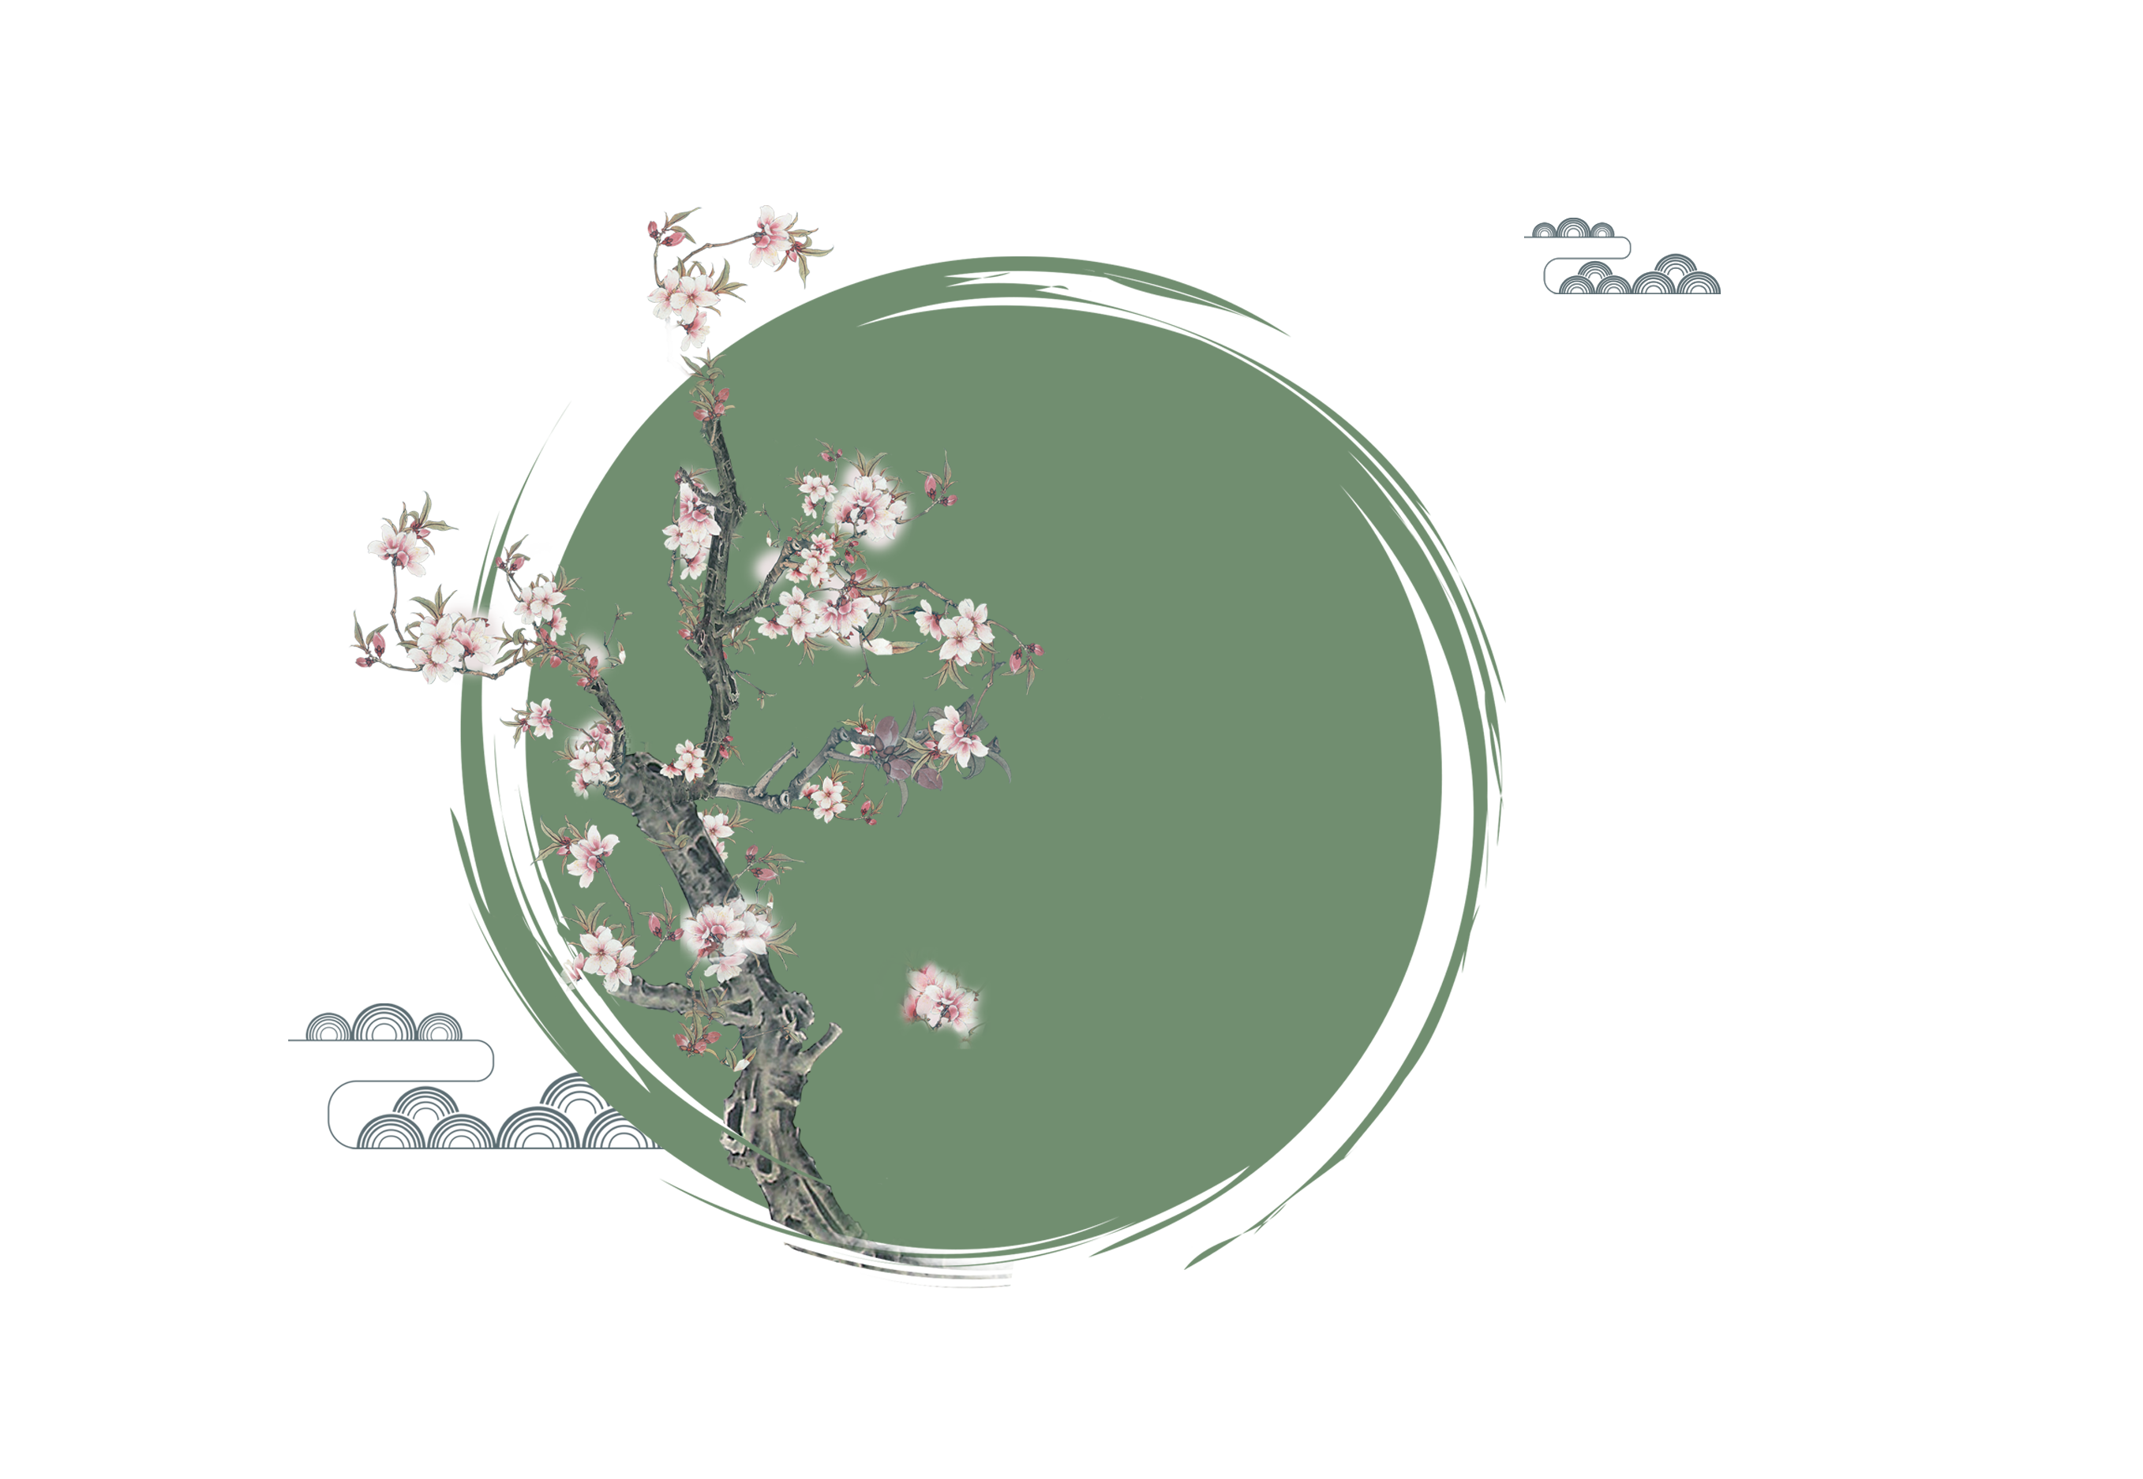
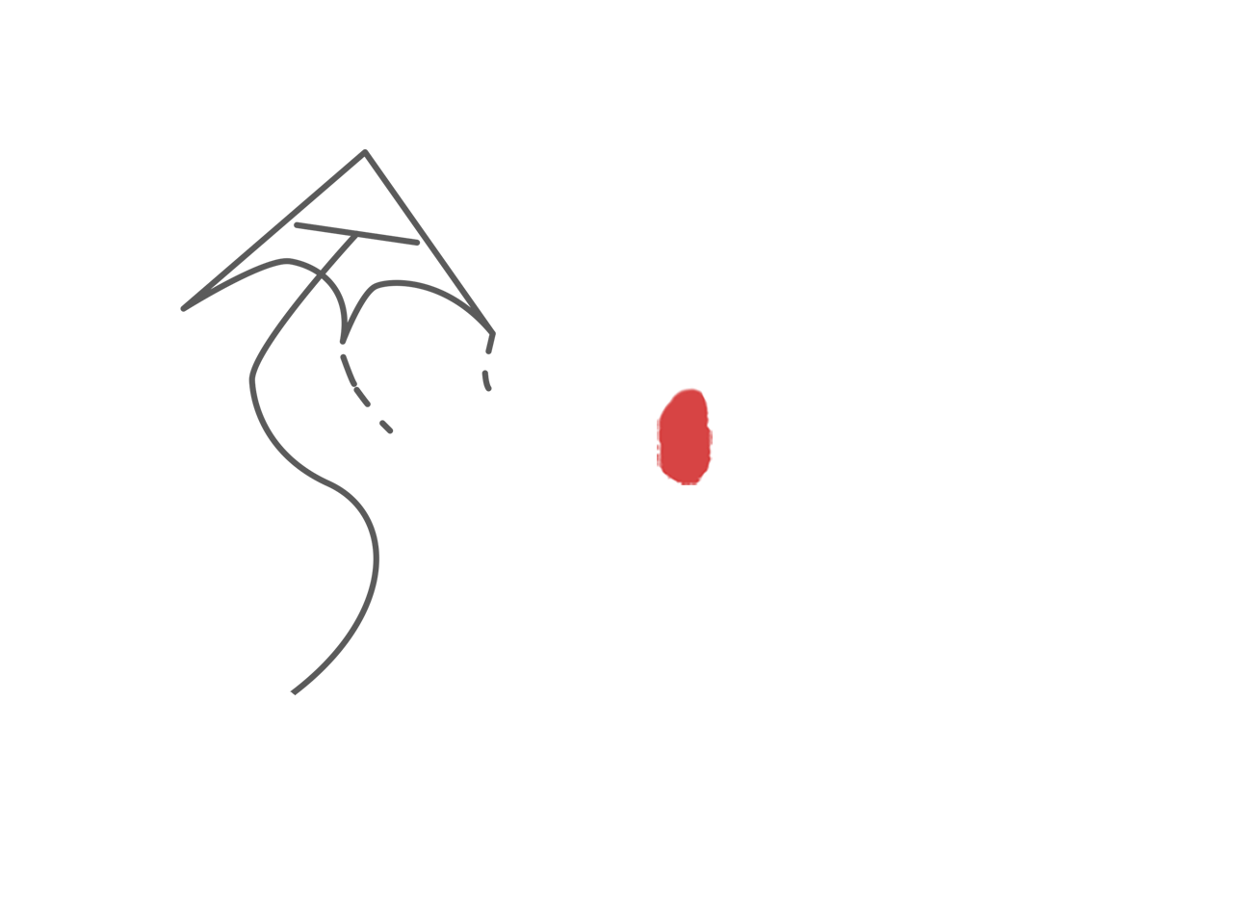
The patriotic sentiment behind the food festival
China
Blood
for
Homeland

Slide 2

The saved
1
Seclusion and visitation
2
content
3
The patriotic sentiment
Fire -driven
4

Slide 3
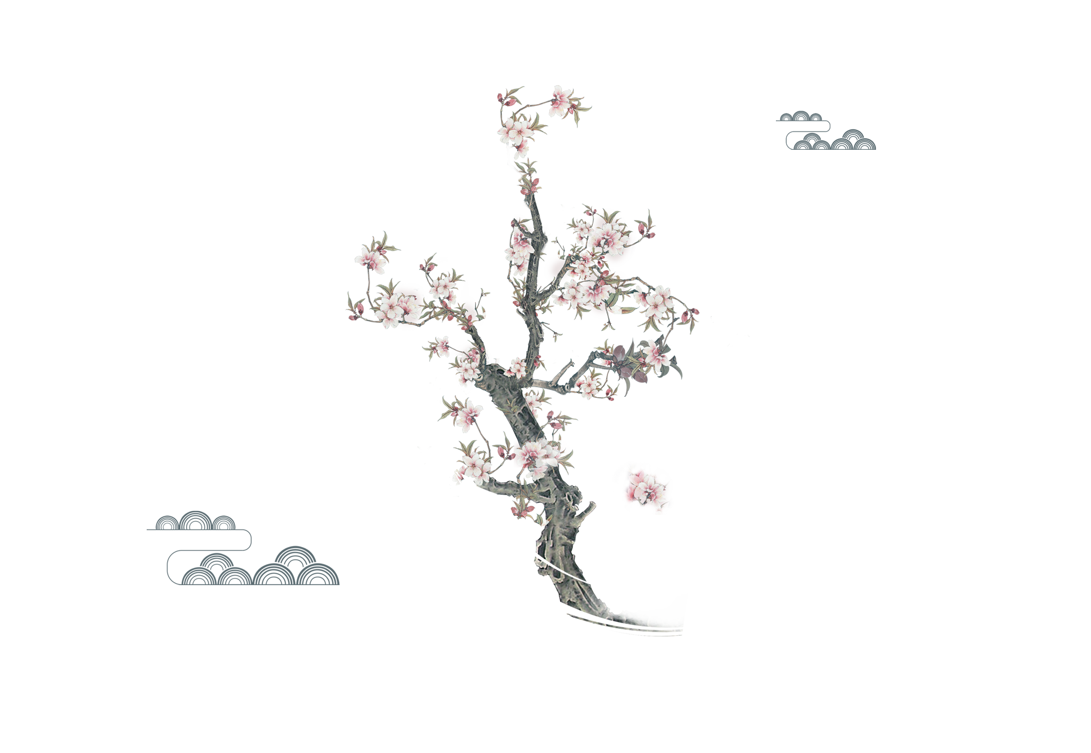
The first chapter
When Chong'er was starving, he was saved by Jie Zitui.

Slide 4
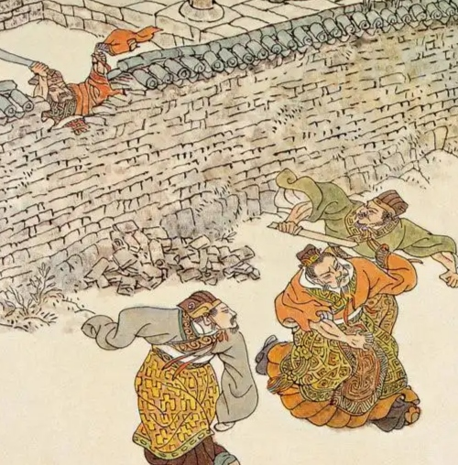
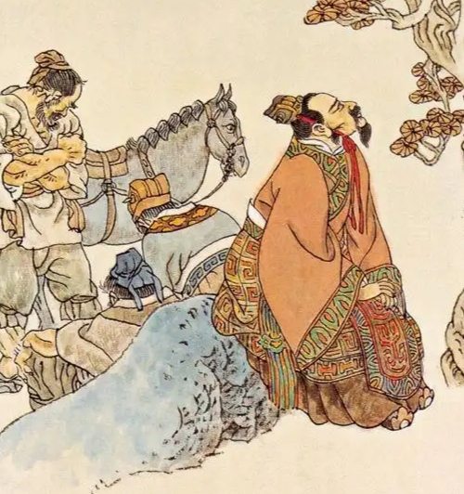
The first chapter
Chong'er fled into exile to aviod civil strif and lived a hard life

Slide 5
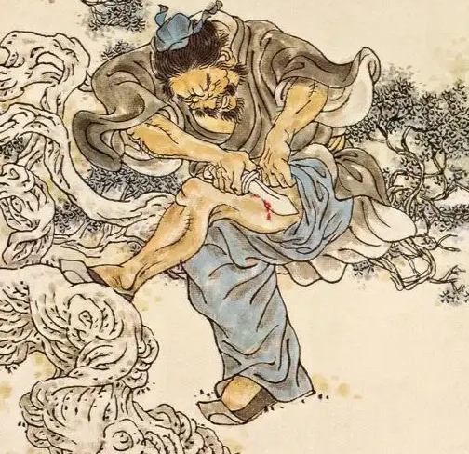
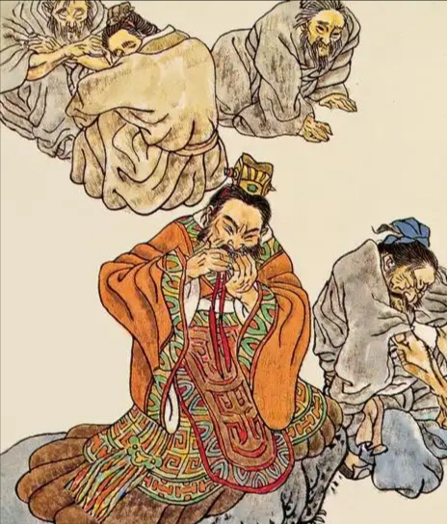
The first chapter
Jie Zitui cut a piece of meat from his own thigh and cooked it into soup for chong'er to relieve his hunger.

Slide 6
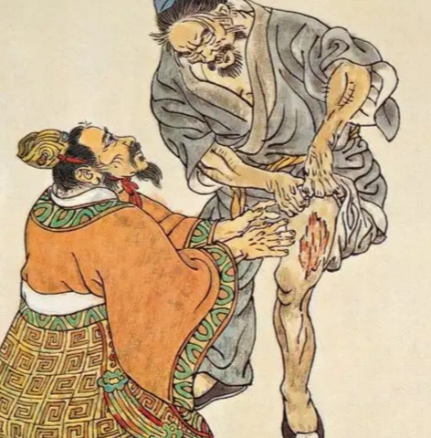
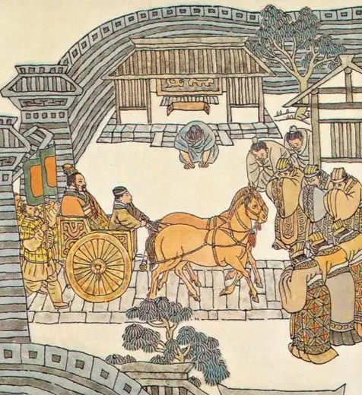
The first chapter
Chong'er was deeply moved and remembered these kindness
Later chong'er returned to jim and ascended the throne as Duke wen of jin

Slide 7
The second chapter
Jie Zitui went into seclusion, and Duke Wen of Jin visited him.

Slide 8
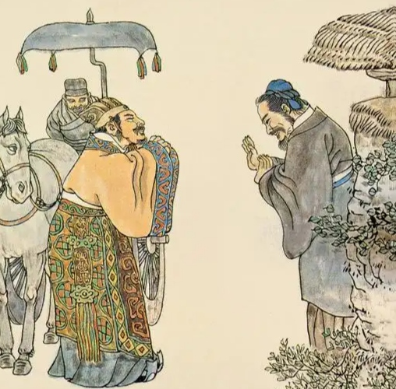
The second chapter
1
Jie zitui was indifferent to fame and fortune and unwilling to boast about his merits or compete for favor, so he carried his old mother and went into seclusion in Mian shan

Slide 9
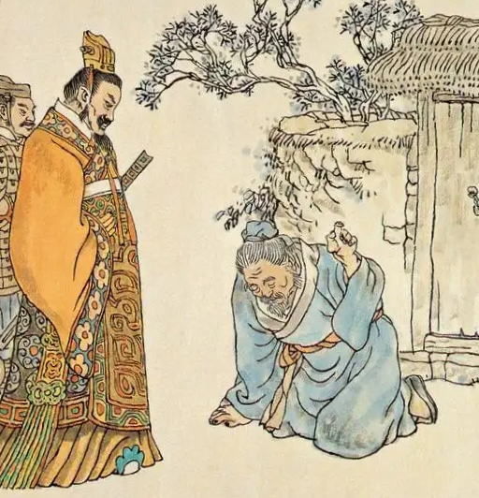
The second chapter
2
When Duke D wenof jin learned about this, he felt deeply guilty and personally went to Mian shan to visit Jietui out .However, Jie zitui refused to emerge.

Slide 10
The third chapter
They set fire to force Jie Zitui out of seclusion, but accidentally killed him.

Slide 11
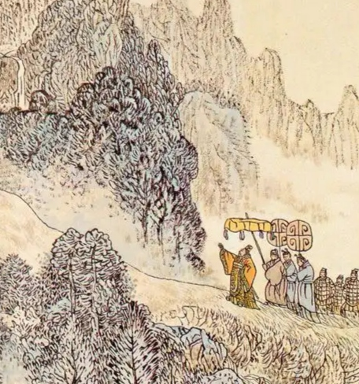
Duke wen believed a minister suggestion
The third chapter

Slide 12
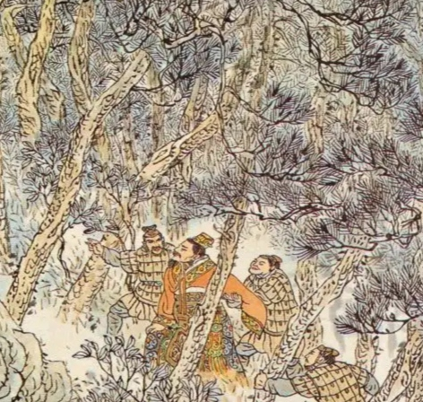
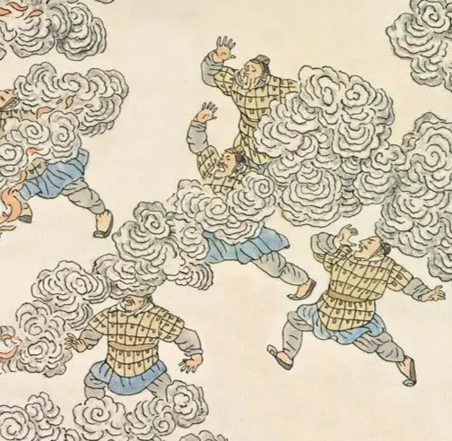
The third chapter
And ordered the mountain to be set on fire to force Jie zitui out

Slide 13
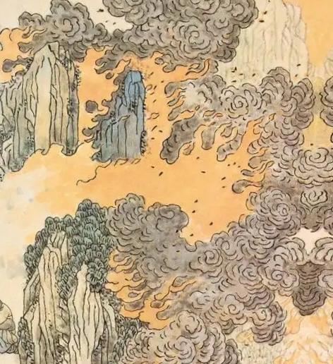
The third chapter
The fire bird for three days and nights
But Jie zitui never appeared

Slide 14
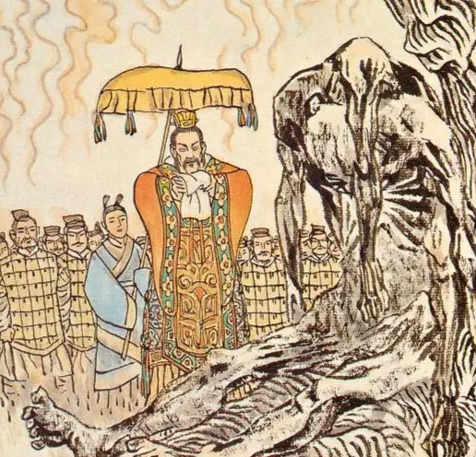
The third chapter
people found Jie zitui and his mother
After the fire was extinguished
burned to death under a big tree hugging
each other
Overcome with grief Duke wen of jin, ordered the day of jin ordered the day of Jiezitui death to be designated as the Cold Food Festival.

Slide 15
The patriotic sentiment behind the Cold Food Festival.
The fourth chapter

Slide 16
The fourth chapter
Jie Zitui cut flesh from his thigh to feed the duke and stayed by his side through hardships, sustaining the duke's life with his own body. This loyalty to the ruler represented a commitment to the country's future and embodied his patriotic spirit. Such spirit is still worth learning for all of us today. Just as Jie Zitui dedicated himself to the duke in ancient times.

Slide 17
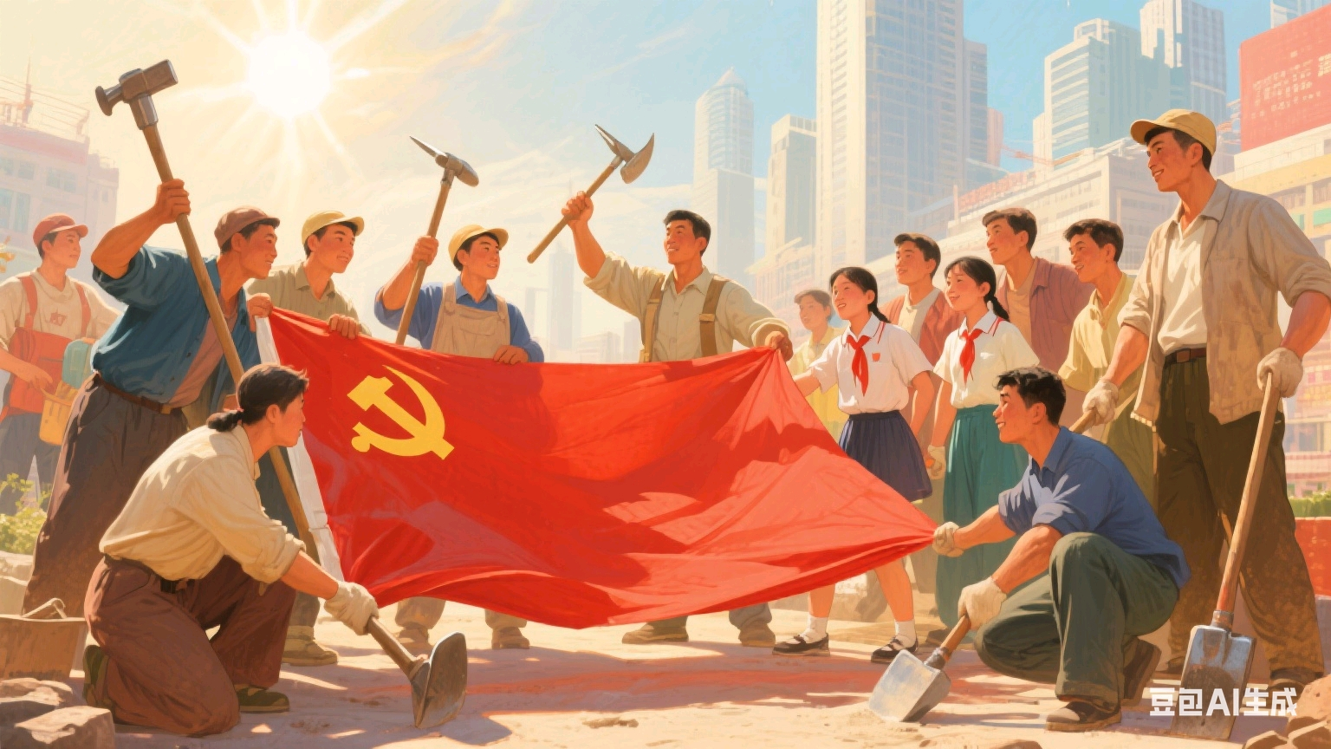
The fourth chapter
people today follow the leadership of the country and the Party, striving forward with determination.

Slide 18
Thank you for your listening
China

